Slide 1
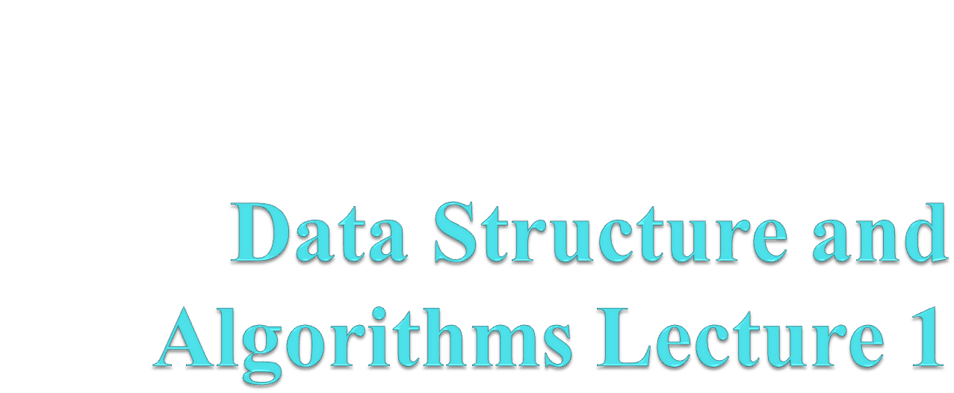
Lecture 1

Slide 2
Course Information
Textbooks
  Introduction to Data Structures in C
  by Ashok N. Kamthane
  Data Structures and Algorithms
  by A. V. Aho, J. E. Hopcroft, J. D. Ullman
  Data Structures Using C and C++
  by Y. Langsam, M. J. Augenstein, A. M. Tenenbaum
  Algorithms in C++
  by Robert Sedgewick

Slide 3
What is Data Structure?
Data structure is a representation of data and the operations allowed on that data.
  A data structure is a way to store and organize data in order to facilitate the access and modifications.
  Data Structure are the method of representing of logical relationships between individual data elements related to the solution of a given problem.

Slide 4
Basic Data Structure
Basic Data Structures
Linear Data Structures
Non-Linear Data Structures
Arrays
Linked Lists
Stacks
Queues
Trees
Graphs
Hash Tables

Slide 5
array
Linked list
queue
tree
stack

Slide 6
Selection of Data Structure
The choice of particular data model depends on two consideration:
  It must be rich enough in structure to represent the relationship between data elements
  The structure should be simple enough that one can effectively process the data when necessary

Slide 7
Types of Data Structure
Linear: In Linear data structure, values are arrange in linear fashion.
  Array: Fixed-size
  Linked-list: Variable-size
  Stack: Add to top and remove from top
  Queue: Add to back and remove from front
  Priority queue: Add anywhere, remove the highest priority

Slide 8
Types of Data Structure
Non-Linear: The data values in this structure are not arranged in order.
  Hash tables: Unordered lists which use a ‘hash function’ to insert and search
  Tree: Data is organized in branches.
  Graph: A more general branching structure, with less strict connection conditions than for a tree

Slide 9
Type of Data Structures
Homogenous: In this type of data structures, values of the same types of data are stored.
  Array
Non-Homogenous: In this type of data structures, data values of different types are grouped and stored.
  Structures
  Classes

Slide 10
Abstract Data Type and Data Structure
Definition:-
  Abstract Data Types (ADTs) stores data and allow various operations on the data to access and change it.
  A mathematical model, together with various operations defined on the model
  An ADT is a collection of data and associated operations for manipulating that data
Data Structures
  Physical implementation of an ADT
  data structures used in implementations are provided in a language (primitive or built-in) or are built from the language constructs (user-defined)
  Each operation associated with the ADT is implemented by one or more subroutines in the implementation

Slide 11
Abstract Data Type
ADTs support abstraction, encapsulation, and information hiding.
Abstraction is the structuring of a problem into well-defined entities by defining their data and operations.
The principle of hiding the used data structure and to only provide a well-defined interface is known as encapsulation.

Slide 12
The Core Operations of ADT
Every Collection ADT should provide a way to:
  add an item
  remove an item
  find, retrieve, or access an item
Many, many more possibilities
  is the collection empty
  make the collection empty
  give me a sub set of the collection

Slide 13
  No single data structure works well for all purposes, and so it is important to know the strengths and limitations of several of them

Slide 14
Stacks
Collection with access only to the last element inserted
Last in first out
insert/push
remove/pop
top
make empty
Data4
Top
Data3
Data2
Data1

Slide 15
Queues
Collection with access only to the item that has been present the longest
Last in last out or first in first out
enqueue, dequeue, front
priority queues and dequeue
Front
Back
Data1
Data2
Data3
Data4

Slide 16
List
A Flexible structure, because can grow and shrink on demand.
Elements can be:
Inserted
Accessed
Deleted
At any position
last
first

Slide 17
Tree
A Tree is a collection of elements called nodes.
One of the node is distinguished as a root, along with a relation (“parenthood”) that places a hierarchical structure on the nodes.
Root

Slide 18
OPERATIONS ON ARRAYS
Various operations that can be performed on an array
Traversing
Insertion
Deletion
Sorting
Searching
Merging

Slide 19
Traversing Linear Array:
Let A be a collection of data elements stored in the memory of the computer.
Suppose we want to print the content of each element of A or suppose we want to count the number of elements of A, this can be accomplished by traversing A, that is, by accessing and processing each element of a exactly ones.

Slide 20
The following algorithm traverses a linear array LA. The simplicity of the algorithm comes from the fact that LA is a linear structure.
Algorithm: (Traversing a Linear Array) Here LA is a linear array with lower bound LB and upper bound UB. This algorithm traverses LA applying an operation PROCESS to each element of LA.
1. [Initialize counter] Set k: =LB.
2. Repeat steps 3 and 4 while k <=UB.
3. [Visit Element] Apply PROCESS to LA [k].
4. [Increase Counter] Set k: =k + 1.
[End of step 2 loop]
5. Exit.

Slide 21
Insertion and Deletion in Linear Array:
Let A be a collection of data elements in the memory of the computer.
“Inserting "refers to the operation of adding another element to the collection A
“Deleting” refers to the operation of removing one element from A.

Slide 22
Insertion in Linear Array:
Inserting an element at the end of the linear array can be easily done provided the memory space allocated for the array is large enough to accommodate the additional element.
We need to insert an element in the middle of the array. Then, on the average, half of the elements must be moved downward to new location to accommodate the new elements and keep the order of the other elements.

Slide 23
Deletion in Linear Array:
Deleting an element at the end of the array presents no difficulties.
Deleting the element somewhere in the middle of the array requires that each subsequent element be moved one location upward in order to fill up the array.

Slide 24
Algorithm for Insertion:
(Inserting into Linear Array) INSERT (LA, N, K, ITEM) Here LA is a linear array with N elements and K is a positive integer such that K<=N. The algorithm inserts an element ITEM into the Kth position in LA.

Slide 25
[Initialize counter] Set J: = N.
2. Repeat Steps 3 and 4 while j >= k;
3. [Move jth element downward.] Set LA [J + 1]: =LA [J].
4. [Decrease counter] Set J: = J-1 [End of step 2 loop] 5. [Insert element] Set LA [K]:=ITEM.
6. [Reset N] Set N:=N+1
7. EXIT.
The following algorithm deletes the Kth element from a linear array LA and assigns it to a variable ITEM.

Slide 26
Algorithm for Deletion: (Deletion from a Linear Array)
DELETE (LA, N, K, ITEM) Here LA is a Linear Array with N elements and K is the positive integer such that K<=N. This algorithm deletes the Kth element from LA.
1. Set ITEM: = LA [k].
2. Repeat for J = K to N – 1.
[Move J + 1st element upward] Set LA [J]: = LA [J +1].
[End of loop]
3. [Reset the number N of elements in LA] Set N: = N-1 4. EXIT

Slide 27
Multidimensional Array
Array having more than one subscript variable is called Multi-Dimensional array.
Multi Dimensional Array is also called as Matrix.

Slide 28
Consider the Two dimensional array –
1. Two Dimensional Array requires Two Subscript Variables
2. Two Dimensional Array stores the values in the form of matrix.
3. One Subscript Variable denotes the “Row” of a matrix.
4. Another Subscript Variable denotes the “Column” of a matrix

Slide 29
Declaration and Use of Two Dimensional Array
int a[3][4];
Use:
for(i=0;i<row;i++)
for(j=0;j<col;j++)
{
printf("%d",a[i][j]);
{

Slide 30
Meaning of Two Dimensional Array :
1. Matrix is having 3 rows ( i takes value from 0 to 2 )
2. Matrix is having 4 Columns ( j takes value from 0 to 3 )
3. Above Matrix 3×4 matrix will have 12 blocks having 3
rows & 4 columns.
4. Name of 2-D array is ‘a’ and each block is identified by
the row & column number.
5. Row number and Column Number Starts from 0.

Slide 31
Cell Location | Meaning
a[0][0] | 0th Row and 0th Column
a[0][1] | 0th Row and 1st Column
a[0][2] | 0th Row and 2nd Column
a[0][3] | 0th Row and 3rd Column
a[1][0] | 1st Row and 0th Column
a[1][1] | 1st Row and 1st Column
a[1][2] | 1st Row and 2nd Column
a[1][3] | 1st Row and 3rd Column
a[2][0] | 2nd Row and 0th Column
a[2][1] | 2nd Row and 1st Column
a[2][2] | 2nd Row and 2nd Column
a[2][3] | 2nd Row and 3rd Column

Slide 32
Two-Dimensional Array : Summary with Sample Example
Summary Point | Explanation
No of Subscript Variables Required | 2
Declaration | a[3][4]
No of Rows | 3
No of Columns | 4
No of Cells | 12
No of for loops required to iterate | 2

Slide 33
Memory Representation
2-D arrays are Stored in contiguous memory location row wise.
Consider 3×3 Array is stored in Contiguous memory location which starts from 4000 .
Array element a[0][0] will be stored at address 4000 again a[0][1] will be stored to next memory location i.e Elements stored row-wise.
After Elements of First Row are stored in appropriate memory location , elements of next row get their corresponding mem. locations.
This is integer array so each element requires 2 bytes of memory.

Slide 34
Element | Memory Location
a[0][0] | 4000
a[0][1] | 4002
a[0][2] | 4004
a[1][0] | 4006
a[1][1] | 4008
a[1][2] | 4010
a[2][0] | 4012
a[2][1] | 4014
a[2][2] | 4016

Slide 35
Array and Row Major, Column Major order arrangement of 2 d array
An array is a list of a finite number of homogeneous data elements. The number of elements in an array is called the array length.
Array length can be obtained from the index set by the formula: Length=UB-LB+1
Where UB is the largest index , called the upper bound and LB is the smallest index , called the lower bound. Suppose int Arr[10] is an integer array.
Upper bound of this array is 9 and lower bound of this array is 0 ,so the length is 9-0+1=10.

Slide 36
In an array ,the elements are stored successive memory cells.
Computer does not need to keep track of the address of every elements in memory.
It will keep the address of the first location only and that is known as base address of an array.
Using the base address , address of any other location of an array can be calculated by the computer.
Suppose Arr is an array whose base address is Base(Arr) and w is the number of memory cells required by each elements of the array Arr.
Address(Arr[k])=Base(Arr)+w(k-LowerBound)
(address of Arr[k] – k being the index value)

Slide 37
Let‘s assume Arr is an two dimensional 2 X 2 array .The array may be stored in memory one of the following way :-
1. Column by column i,e column major order
2. Row by row , i,e in row major order. The following figure shows both representation of the above array.
Row Major:
1,1
2,1
1,2
2,2

Slide 38
Column-major order , the subscript at the extreme left changes rapidly ,
then the subscript at it‘s right.
Column Major Order
1,1
1,2
2,1
2,2

Slide 39
Example
Arr[j,k] of a 2 d array Arr[m,n] can be calculated by using the following formula :-
(Column major order ) Address(Arr[j,k])= base(Arr)+w[m(k-1)+(j-1)]
(Row major order) Address(Arr[j,k])=base(Arr)+w[n(j-1)+(k-1)]
For example Arr(25,4) is an array with base value 200.w=4 for this array. The
address of Arr(12,3) can be calculated using row-major order.
Address(Arr(12,3))=200+4[4(12-1)+(3-1)]
=200+4[4*11+2]
=200+4[44+2]
=200+4[46]
=200+184
=384

Slide 40
Again using column-major order
Address(Arr(12,3))=200+4[25(3-1)+(12-1)]
=200+4[25*2+11]
=200+4[50+11]
=200+4[61]
=200+244
=444

